Slide 1
LUJAN GRISHAM ADMINISTRATION
TRIBAL INFRASTRUCTURE INVESTMENTS
2019-2021

Slide 2
TRIBAL INVESTMENTS
INDIAN AFFAIRS DEPARTMENT
OTHER AGENCIES
2019-2021

Slide 3
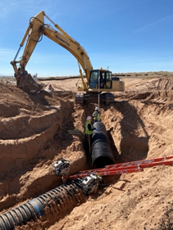
TRIBAL INFRASTRUCTURE INVESTMENTS IN
WATER & WASTEWATER
  ACOMA PUEBLO (2021)
  COCHITI PUEBLO (2020 - 2021)
  FORT STILL APACHE TRIBE (2019,2020)
  ISLETA PUEBLO (2021)
  JEMEZ PUEBLO (2021)
  JICARILLA APACHE NATION (2019, 2020)
  MESCALERO APACHE TRIBE (2021)
  NAMBE PUEBLO (2019, 2020)
  NAVAJO NATION (2019 – 2021)
  OHKAY OWINGEH (2019 – 2021)
•PICURIS PUEBLO (2019)
• POJOAQUE PUEBLO (2019, 2021)
•SAN FELIPE PUEBLO (2019, 2021)
•SAN ILDEFONSO PUEBLO (2019, 2021)
•SANDIA PUEBLO (2019)
•SANTA CLARA PUEBLO (2019, 2021)
•SANTO DOMINGO PUEBLO (2019)
•TESUQUE PUEBLO (2021)
•ZUNI PUEBLO (2019, 2021)
TOTAL TRIBAL INVESTMENTS
$70,951,810
2019-2021

Slide 4
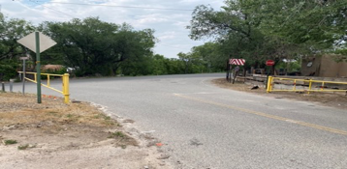
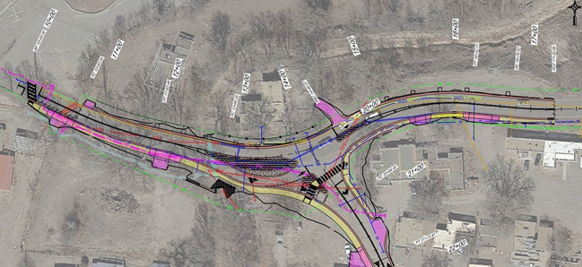
TRIBAL INFRASTRUCTURE INVESTMENTS IN
PUBLIC SAFETY
•LAGUNA PUEBLO (2019 - 2021)
•ISLETA PUEBLO (2019, 2021)
•JICARILLA APACHE NATION (2021)
•MESCALERO APACHE TRIBE (2021)
•NAVAJO NATION (2019 - 2021)
•NAVAJO PREP (2021)
•SANDIA PUEBLO (2019 - 2021)
•SANTA ANA PUEBLO (2021)
•SANTA FE INDIAN SCHOOL (2019-2020)
•ZIA PUEBLO (2021)
•OHKAY OWINGEH (2021)
•NAMBE PUEBLO (2020)
•TAOS PUEBLO (2019 - 2021)
TOTAL TRIBAL INVESTMENTS
$42,911,786
2019-2021

Slide 5

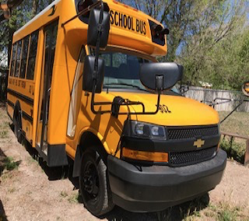
TRIBAL INFRASTRUCTURE INVESTMENTS IN
EDUCATION
•DINE COLLEGE (2019, 2021 )
•INSTITUTE OF AMERICAN INDIAN ARTS (2021)
•JEMEZ PUEBLO (2019 - 2021)
•JICARILLA APACHE NATION (2021)
•MESCALERO APACHE TRIBE (2019)
•NAVAJO NATION (2019 )
•NAVAJO PREP (2021 )
•NAVAJO TECH. UNIVERSITY (2019 )
TOTAL TRIBAL INVESTMENTS
$17,552,735
2019-2021

Slide 6
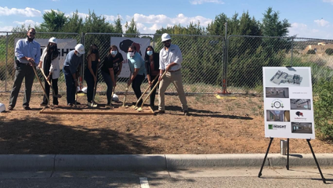
TRIBAL INFRASTRUCTURE INVESTMENTS IN
HEALTH & WELLNESS
•ACOMA PUEBLO (2019)
•NAMBE PUEBLO (2019 - 2021)
•PICURIS PUEBLO (2020)
•POJOAQUE PUEBLO (2019 - 2021)
•OHKAY OWINGEH (2021)
•SANTA CLARA PUEBLO (2019)
•SAN FELIPE PUEBLO (2021)
•TAOS PUEBLO (2021)
TOTAL TRIBAL INVESTMENTS
$7,494,061
2019-2021

Slide 7
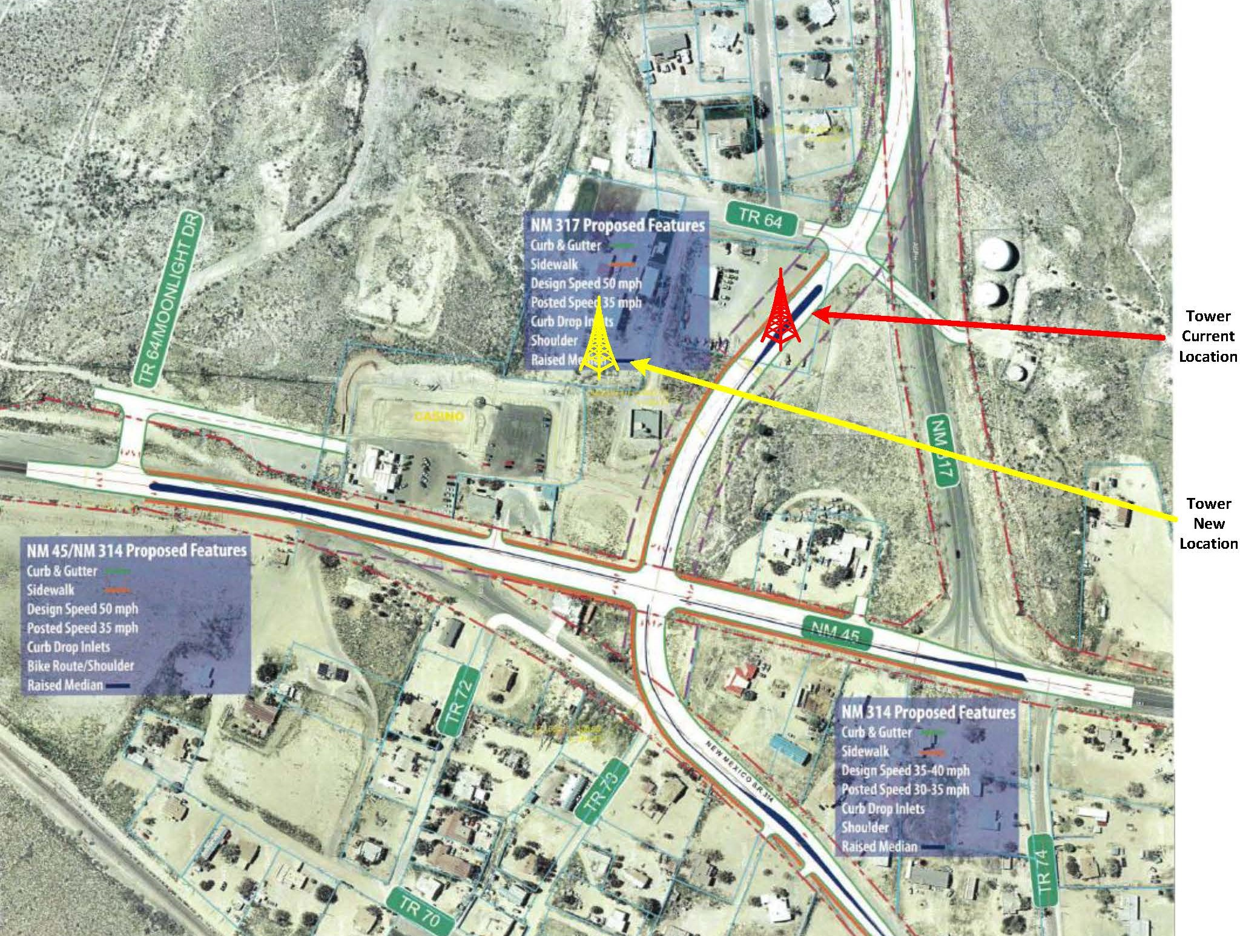
TRIBAL INFRASTRUCTURE INVESTMENTS IN
BROADBAND & COMMUNICATIONS
•ACOMA PUEBLO (2021)
•COCHITI PUEBLO (2020)
•ISLETA PUEBLO (2020)
•JEMEZ PUEBLO (2019)
•JICARILLA APACHE NATION (2019)
•NAMBE PUEBLO(2021)
•NAVAJO NATION (2021)
•POJOAQUE PUEBLO (2021)
•SAN ILDEFONSO PUEBLO (2021)
•SANTA FE INDIAN SCHOOL(2021)
TOTAL TRIBAL INVESTMENTS
$13,537,843
2019-2021

Slide 8
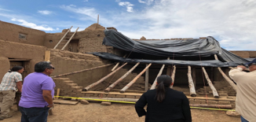
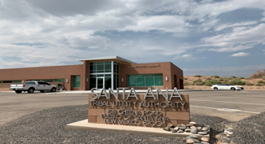
TRIBAL INFRASTRUCTURE INVESTMENTS IN
HOUSING & UTILITIES
TOTAL HOUSING INVESTMENTS
•NAVAJO NATION (2019 -2021)
• SANTO DOMINGO PUEBLO (2020 - 2021)
•TAOS PUEBLO (2019 -2021)
$6,900,000
TOTAL UTILITY INVESTMENTS
•ACOMA PUEBLO (2019)
•SAN FELIPE PUEBLO (2021)
•SANTA ANA PUEBLO (2019 - 2021)
•NAVAJO NATION (2020 - 2021)
•SANTO DOMINGO PUELBO (2021)
$12,362,477

Slide 9
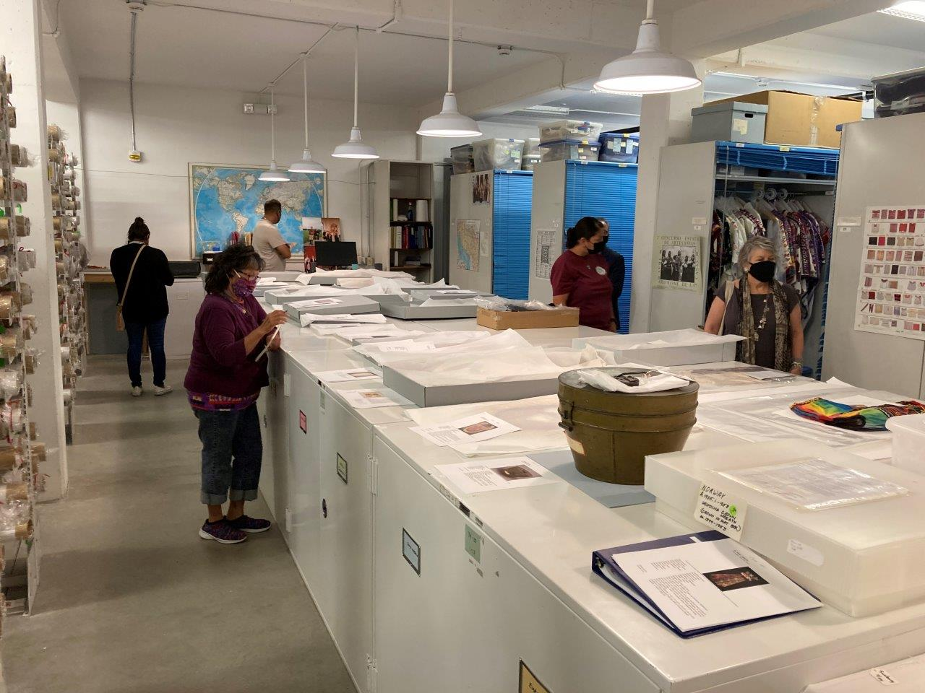
TRIBAL INFRASTRUCTURE INVESTMENTS IN
ECONOMIC DEVELOPMENT
•ACOMA PUEBLO (2019 -2021)
•INDIAN PUEBLO CULTURAL CENTER (2019, 2021)
•NAVAJO NATION (2019)
•SAN ILDEFONSO PUEBLO (2019 -2021)
•TAOS PUEBLO (2019)
TOTAL ECONOMIC DEVELOPMENT INVESTMENTS
$13,428,973
2019-2021

Slide 10
LUJAN GRISHAM ADMINISTRATION
TRIBAL INFRASTRUCTURE INVESTMENTS
2019-2021

